Slide 1

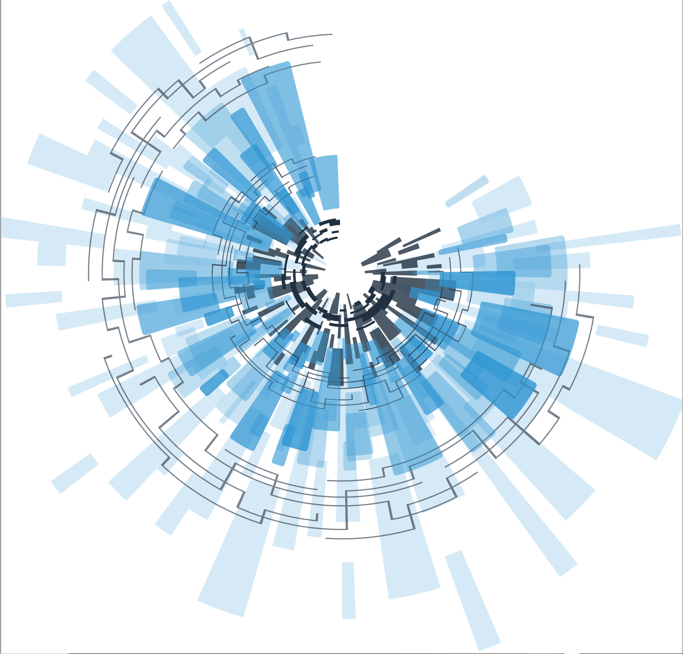
Council for Outbreak Response:
Healthcare-Associated Infections
Antibiotic-Resistant Pathogens
Joe Perz, DrPH MA
CDC/DHQP/PRB
CORHA Governance Committee Member
ICEID 2018

Slide 2

Problem
Despite significant progress, patients still experience preventable harms in the form of outbreaks and adverse events due to delayed recognition of emerging infectious diseases, unsafe healthcare practices, and contaminated drugs, and medical device risks
Notes:
These events require a response – a series of actions to assess risk and prevent further harm

Slide 3
What do we mean by “Response” in the context of HAIs and AR Threats?
Response refers to efforts to assist with assessment and investigation of specific, acute HAI/AR risks
These risks can take various forms
  outbreaks
  clusters of infections
  sentinel cases (e.g., HAI or emerging AR threat), or
  a serious breach in infection control practice
Notes:
All of these may represent uncontrolled preventable patient risks --- 2-3-4 have outbreak potential that needs investigation and mitigation
Specific as in manifesting at a particular population and point in time… recognizing something “new”
Acute aka newly recognized

Slide 4
Need
More systematic and consistent approach to healthcare outbreak response, from signal detection to investigation and control
Notes:
We respond to signals. But first we have to recognize them.

Slide 5

Notes:
I think I see a signal what about you. Should we wait for it to become more clear?
These events require a response – a series of actions to assess risk and prevent further harm

Slide 6
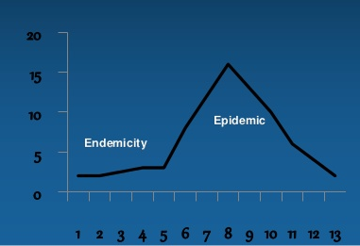
  Basic tenet: sooner we become aware of a potential problem, the more opportunity to attenuate harms
  Ba
Notes:
Basic tenet for public health and really any kind of endeavor where one seeks to maintain high levels of quality

Slide 7
HAI/AR Response
– Investigation Goals and Activities
  Goals
    Prevent harm
    Assess for and control risks
    Rule out larger problem
  Activities
    Case finding
    Audit infection control and care delivery
    Evaluate transmission potential/mechanisms
    Implement control measures
Notes:
Signals require a response – a series of actions to assess risk and prevent further harm
Internal and external record review
patient notification (“recall”) considerations
Evaluate transmission mechanisms
Perform risk assessment

Slide 8
Council for Outbreak Response:
Healthcare-Associated Infections & Antibiotic-Resistant Pathogens
To improve practices and policies at the local, state and national levels for detection, investigation, control and prevention of HAI/AR outbreaks across the healthcare continuum, including emerging infections and other risks.
Mission
Vision
Public health and healthcare collaborating effectively to protect patients and prevent harms from HAI/AR outbreaks.
Notes:
Public health and healthcare (emphasize)

Slide 9

CORHA Structure
ASTHO
Gerd Clabaugh, Iowa
CSTE
Marion Kainer, Tennessee
Governance Committee
CDC
Joe Perz,
CDC/DHQP
NACCHO
Dawn Terashita, Los Angeles County
Member Organizations
SHEA
APIC
APHL
FDA
CMS
FDA
Notes:
CDC = funder

Slide 10

CORHA Product Pipeline
  Suite of condition- or event-specific reference tools
  Thresholds for investigation/reporting
  Tools for investigation
  Suggestions for standardized control measures
  Prototype: Scabies; pipeline: C. auris, CRE, CDI, NTM
  Searchable clearinghouse
  Investigation tools and resources
  HAI/AR outbreak response abstracts from select annual meetings
  High-level guidance (“best practices”) related to strategic objectives

Slide 11
CORHA Strategic Map – Priorities A and B
Support Standardized Approaches to Detection and Reporting
Support Consistent and Coordinated Approaches to Investigation & Control
Workgroups
Standardize Outbreak & Adverse Event
Definitions & Thresholds for Reporting
Define Appropriate
Levels of Response
Improve Reporting of Outbreaks and
Exposure Events to Public Health
Improve Response
to Outbreaks
Improve the Use of Existing Surveillance
Systems to Detect Outbreaks
Improve Data Management for
Outbreak Investigation and Tracking
Define Public Health, Clinical, and Commercial Laboratory Best Practices
to Support Outbreak Detection and Response
Explore Legal Authority to Support Best Practices
Develop Tools and Guidance
Notes:
Let’s redraw and zoom in

Slide 12
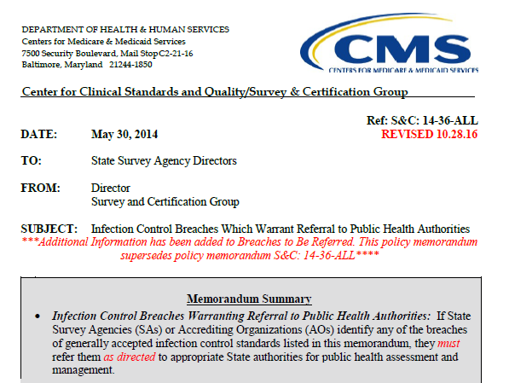
Example – Serious Infection Control Breach Reporting Requirement
Trigger for Reporting is clearly spelled out
Includes reuse of injection equipment and breakdowns in reprocessing or sterilization
Provides opportunity for health department to assess, assist and intervene
Elevates these practices
Notes:
Something we can try to emulate
--- helps to take the guesswork out
--- discretion is good but too much is problematic

Slide 13
CORHA Strategic Map – Priorities A and B
Support Standardized Approaches to Detection and Reporting
Support Consistent and Coordinated Approaches to Investigation & Control
Workgroups
Standardize Outbreak & Adverse Event
Definitions & Thresholds for Reporting
Define Appropriate
Levels of Response
Improve Reporting of Outbreaks and
Exposure Events to Public Health
Improve Response
to Outbreaks
Improve the Use of Existing Surveillance
Systems to Detect Outbreaks
Improve Data Management for
Outbreak Investigation and Tracking
Define Public Health, Clinical, and Commercial Laboratory Best Practices
to Support Outbreak Detection and Response
Explore Legal Authority to Support Best Practices
Develop Tools and Guidance
Notes:
Let’s redraw and zoom in

Slide 14
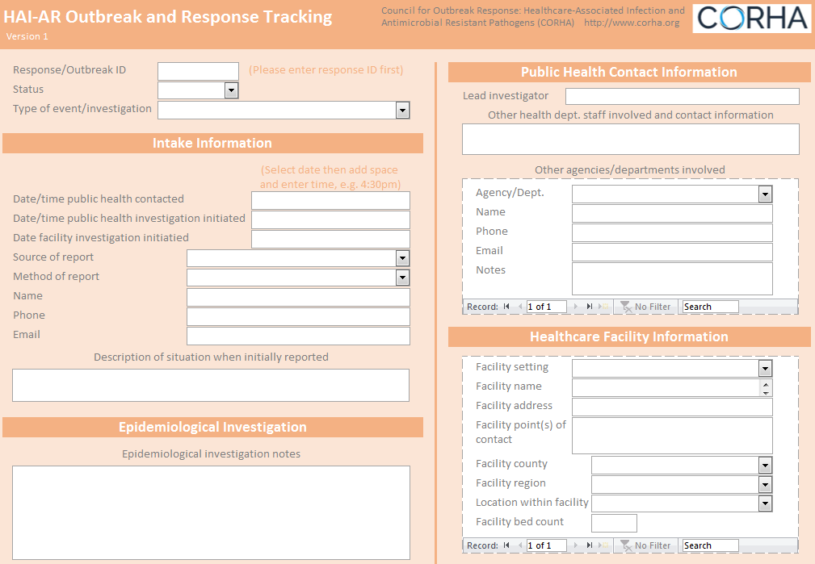
CORHA Response Activity Tracking System
  Aim: help health departments and large healthcare systems with tracking summary data from response activities
  Materials include a sample database (provided in the form of a downloadable Microsoft Access file) and data dictionary
Notes:
Track RESPONSE ACTIVITY not just defined outbreak events

Slide 15
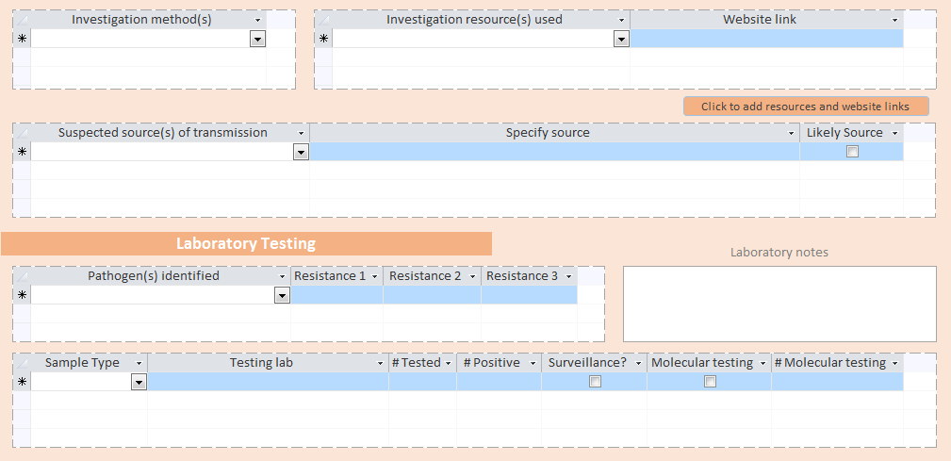

Slide 16
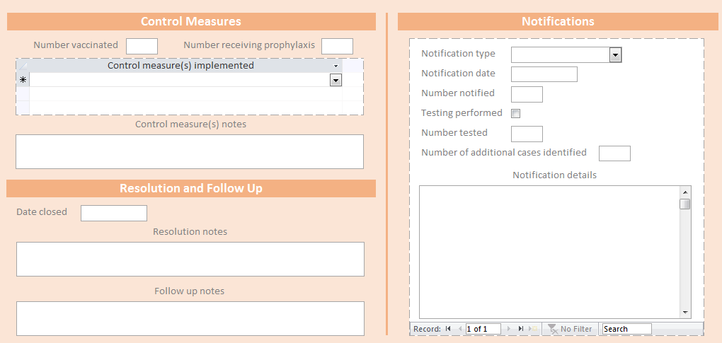

Slide 17
CORHA Strategic Map – Priorities A and B
Support Standardized Approaches to Detection and Reporting
Support Consistent and Coordinated Approaches to Investigation & Control
Workgroups
Standardize Outbreak & Adverse Event
Definitions & Thresholds for Reporting
Define Appropriate
Levels of Response
Improve Reporting of Outbreaks and
Exposure Events to Public Health
Improve Response
to Outbreaks
Improve the Use of Existing Surveillance
Systems to Detect Outbreaks
Improve Data Management for
Outbreak Investigation and Tracking
Define Public Health, Clinical, and Commercial Laboratory Best Practices
to Support Outbreak Detection and Response
Explore Legal Authority to Support Best Practices
Develop Tools and Guidance
Notes:
Let’s redraw and zoom in

Slide 18
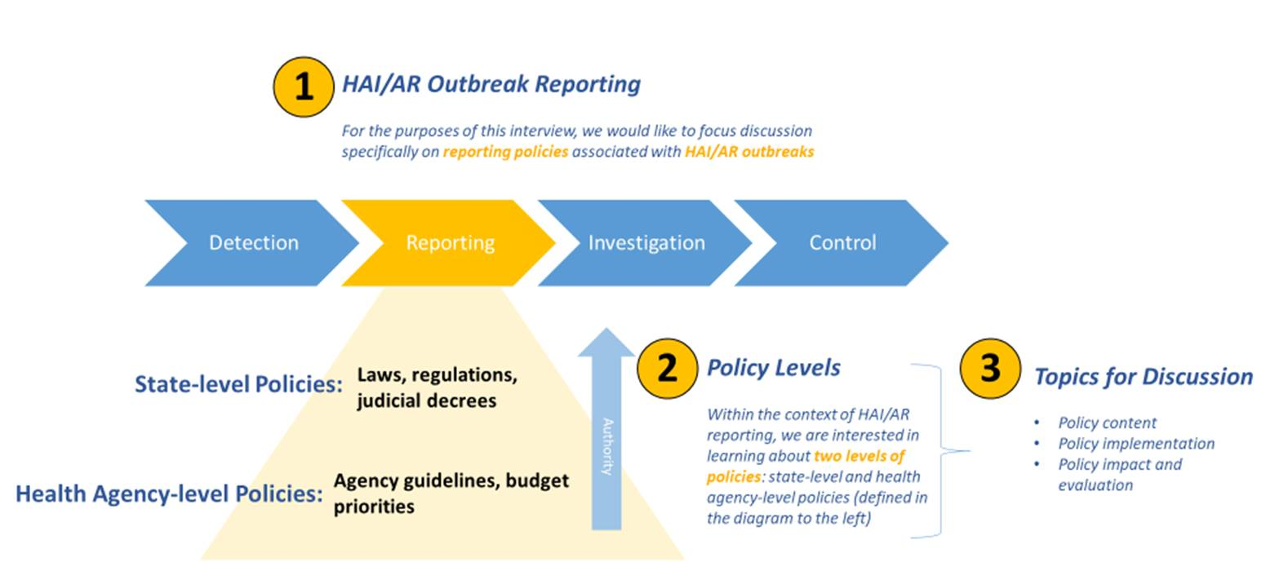

Evaluation of State HAI/AR Outbreak Reporting Policies and Practices
Notes:
ASTHO explore the nature of your state’s healthcare-associated infections and antibiotic-resistant pathogen outbreak reporting policy(ies) and build upon the HAI/AR outbreak response capacities assessment that your state health department participated in as part of the ICAR program

Slide 19
CORHA – Summary
  Healthcare outbreak response activities are being elevated and recognized as a core component of HAI/AR prevention and containment strategies
  The Council is evolving into a practical forum for the healthcare community, consumers, public health authorities, and professional associations to address the challenges of HAI/AR outbreak response
Poster #183 Tuesday: CORHA evaluation of outbreak detection tools and methods

Slide 20

Thank You
The findings and conclusions in this report are those of the authors and do not necessarily represent the official position of the Centers for Disease Control and Prevention.

Slide 21
Some other topics/issues CORHA is working on
  Medical Product Investigations
  Drug Diversion
  Patient Notification and Public Disclosure
  Workforce capacity/training
  Advice on Planning and Preparation

